Slide 1

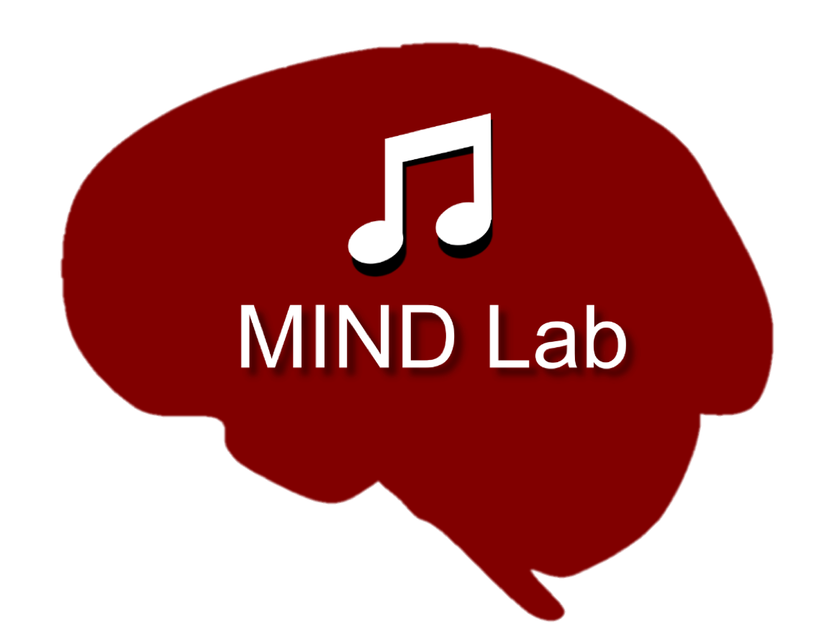
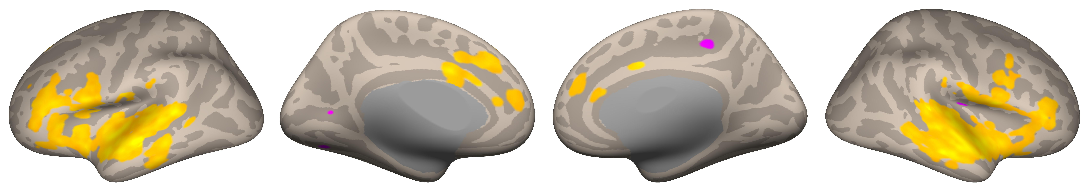
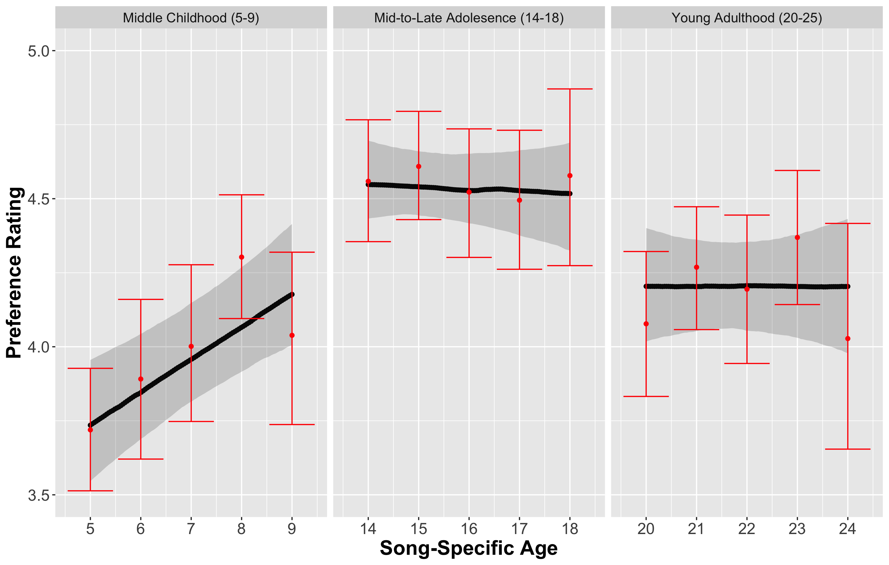
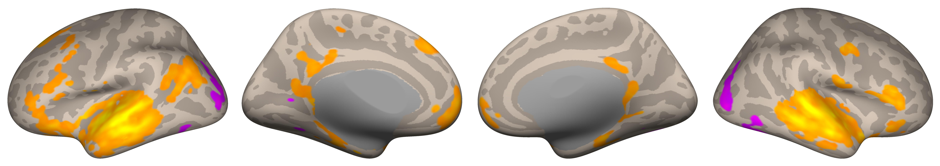
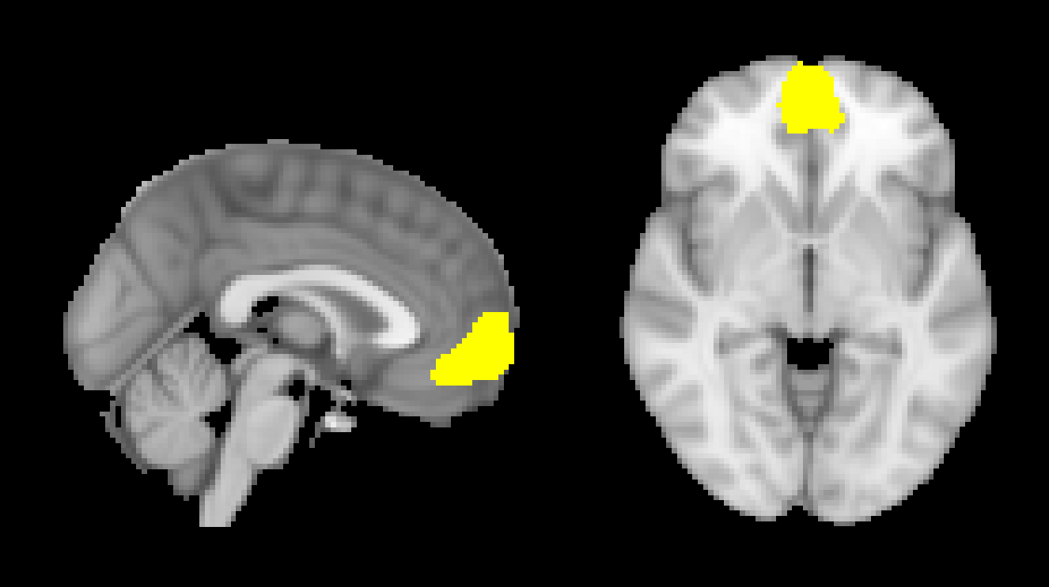
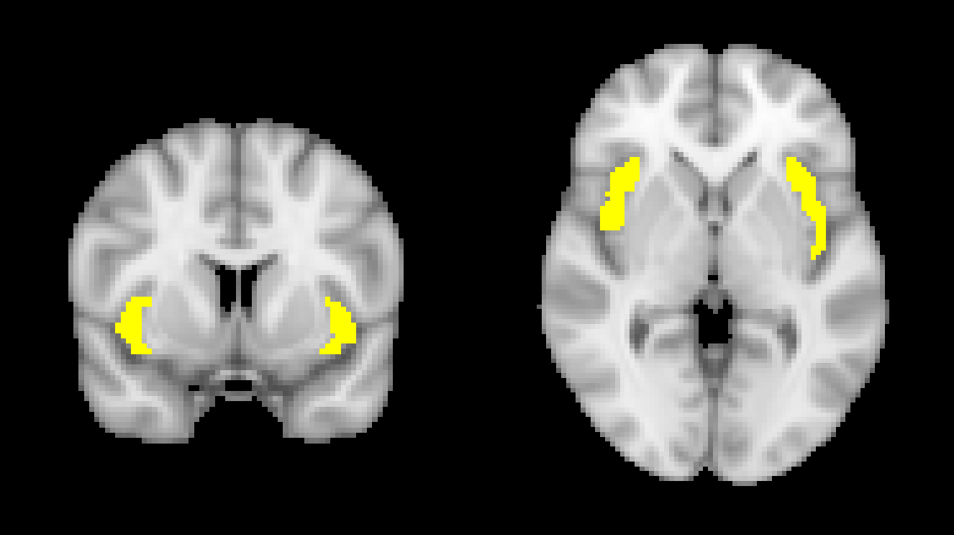
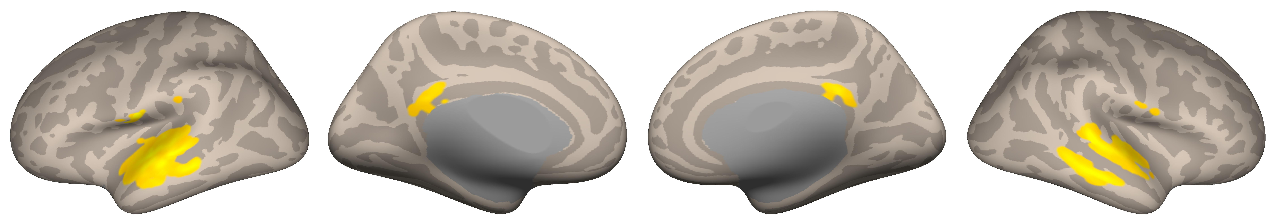
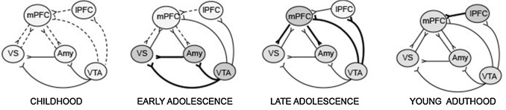
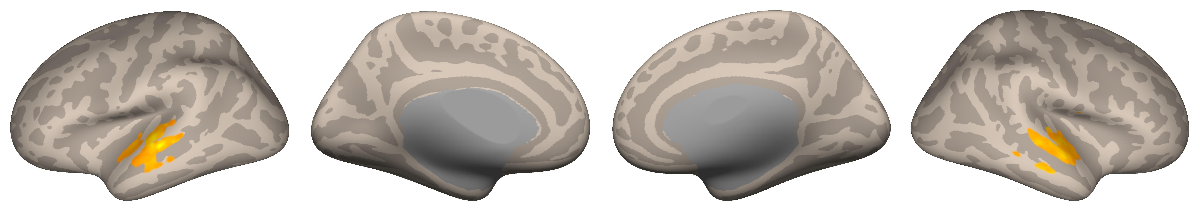
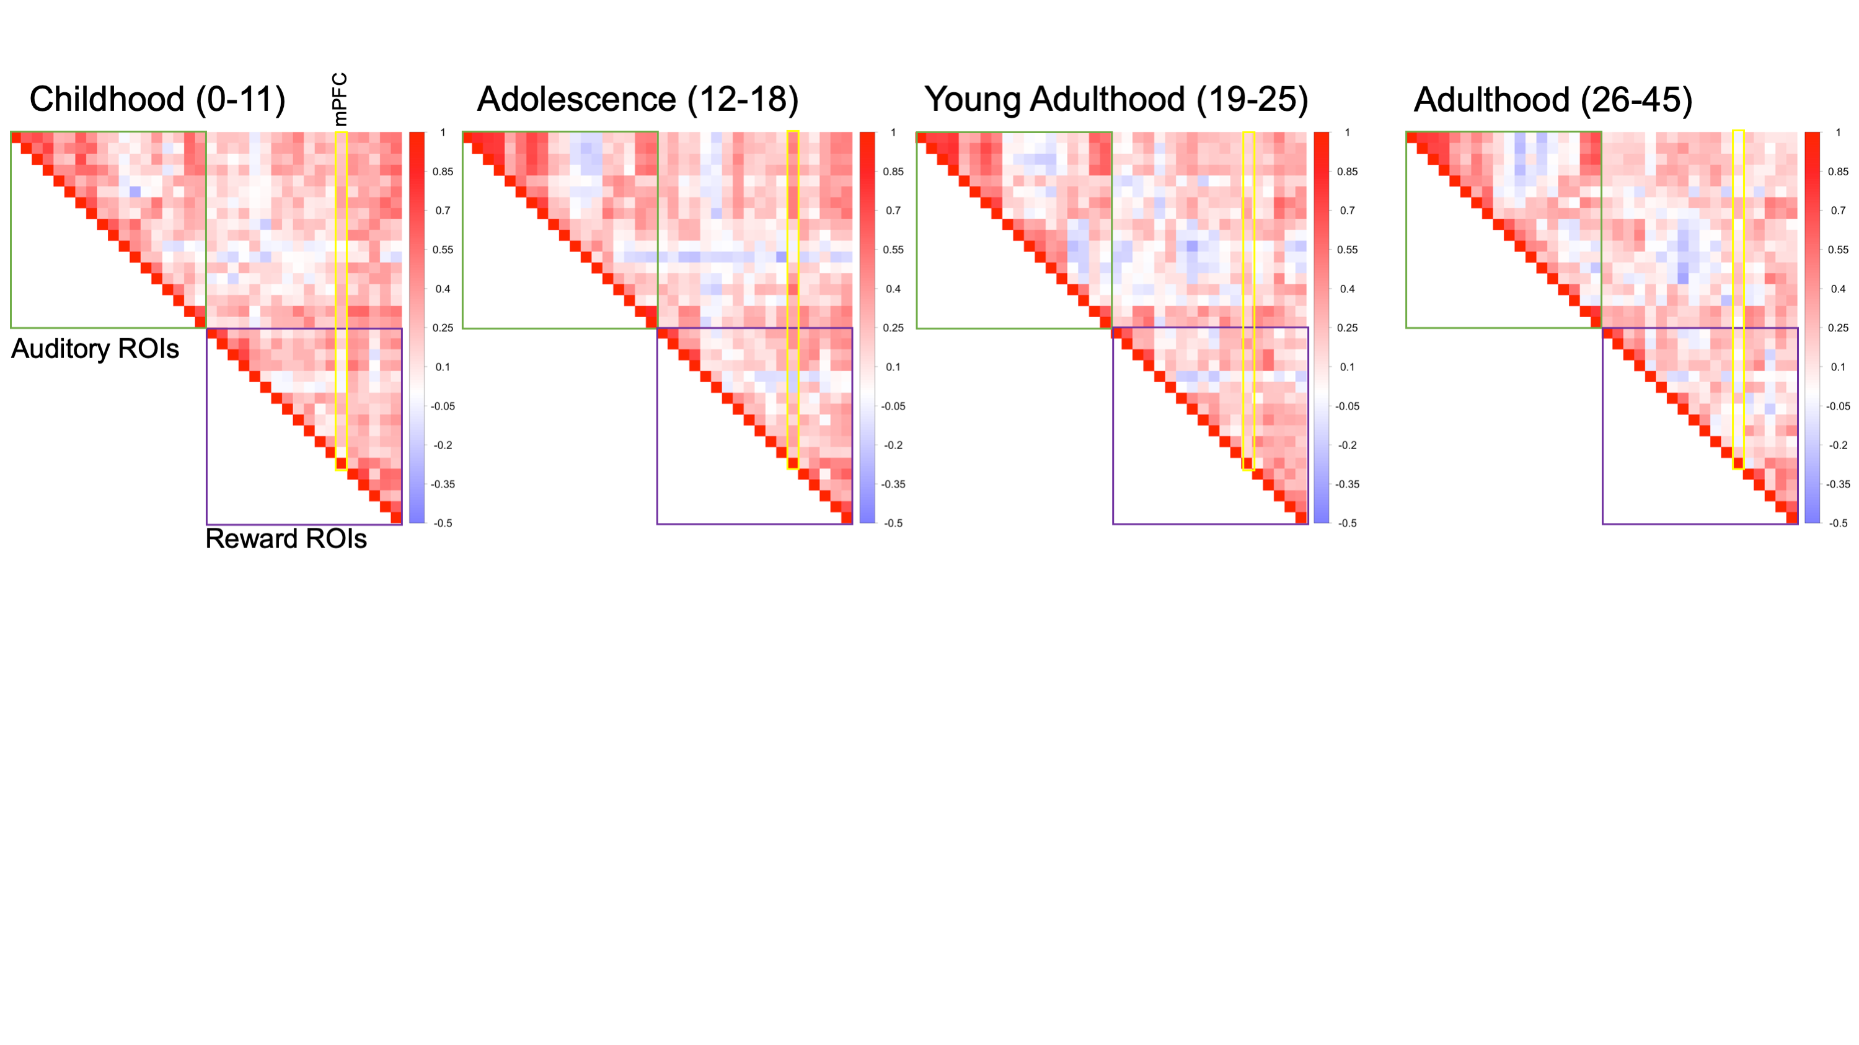
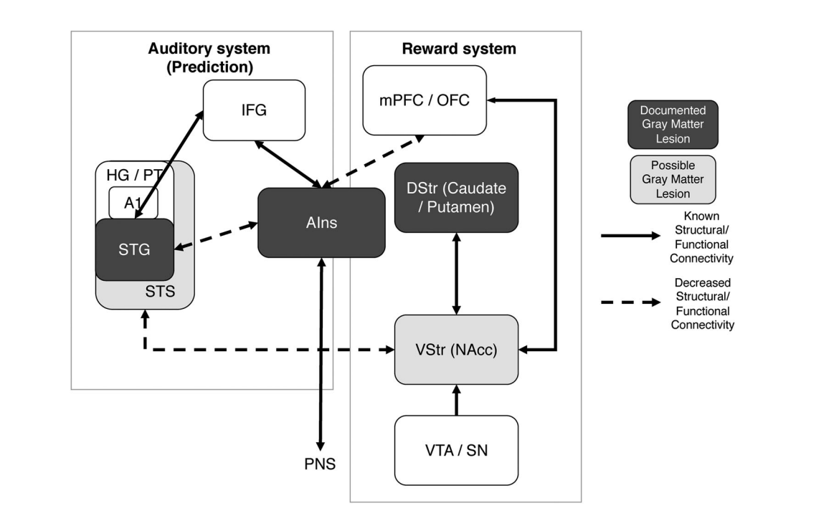
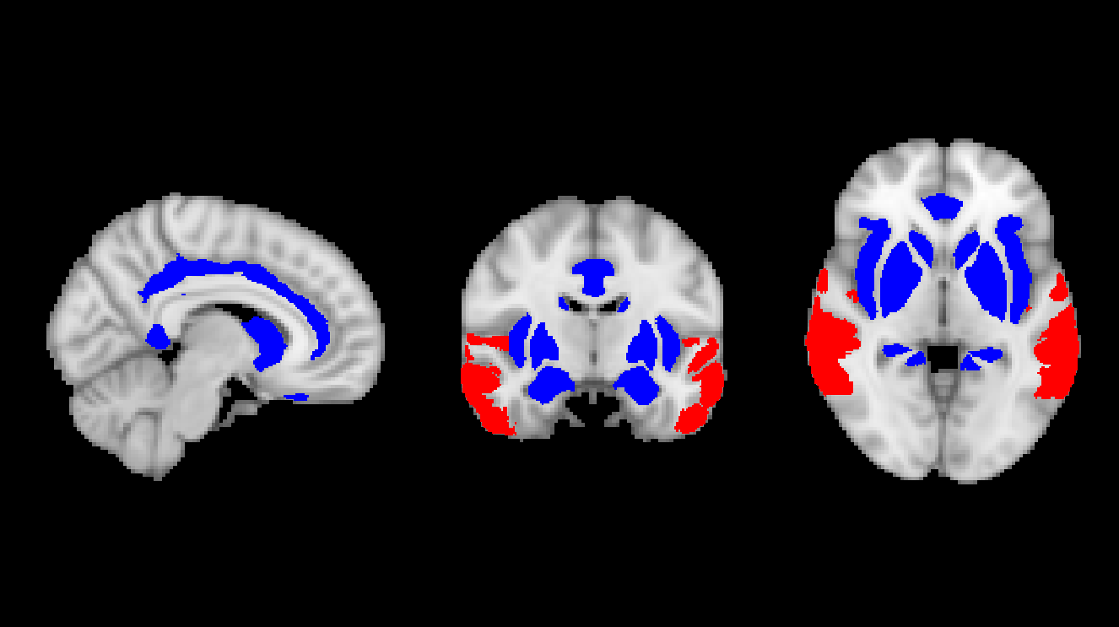
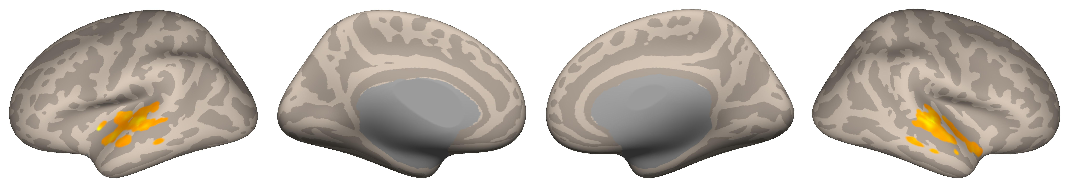
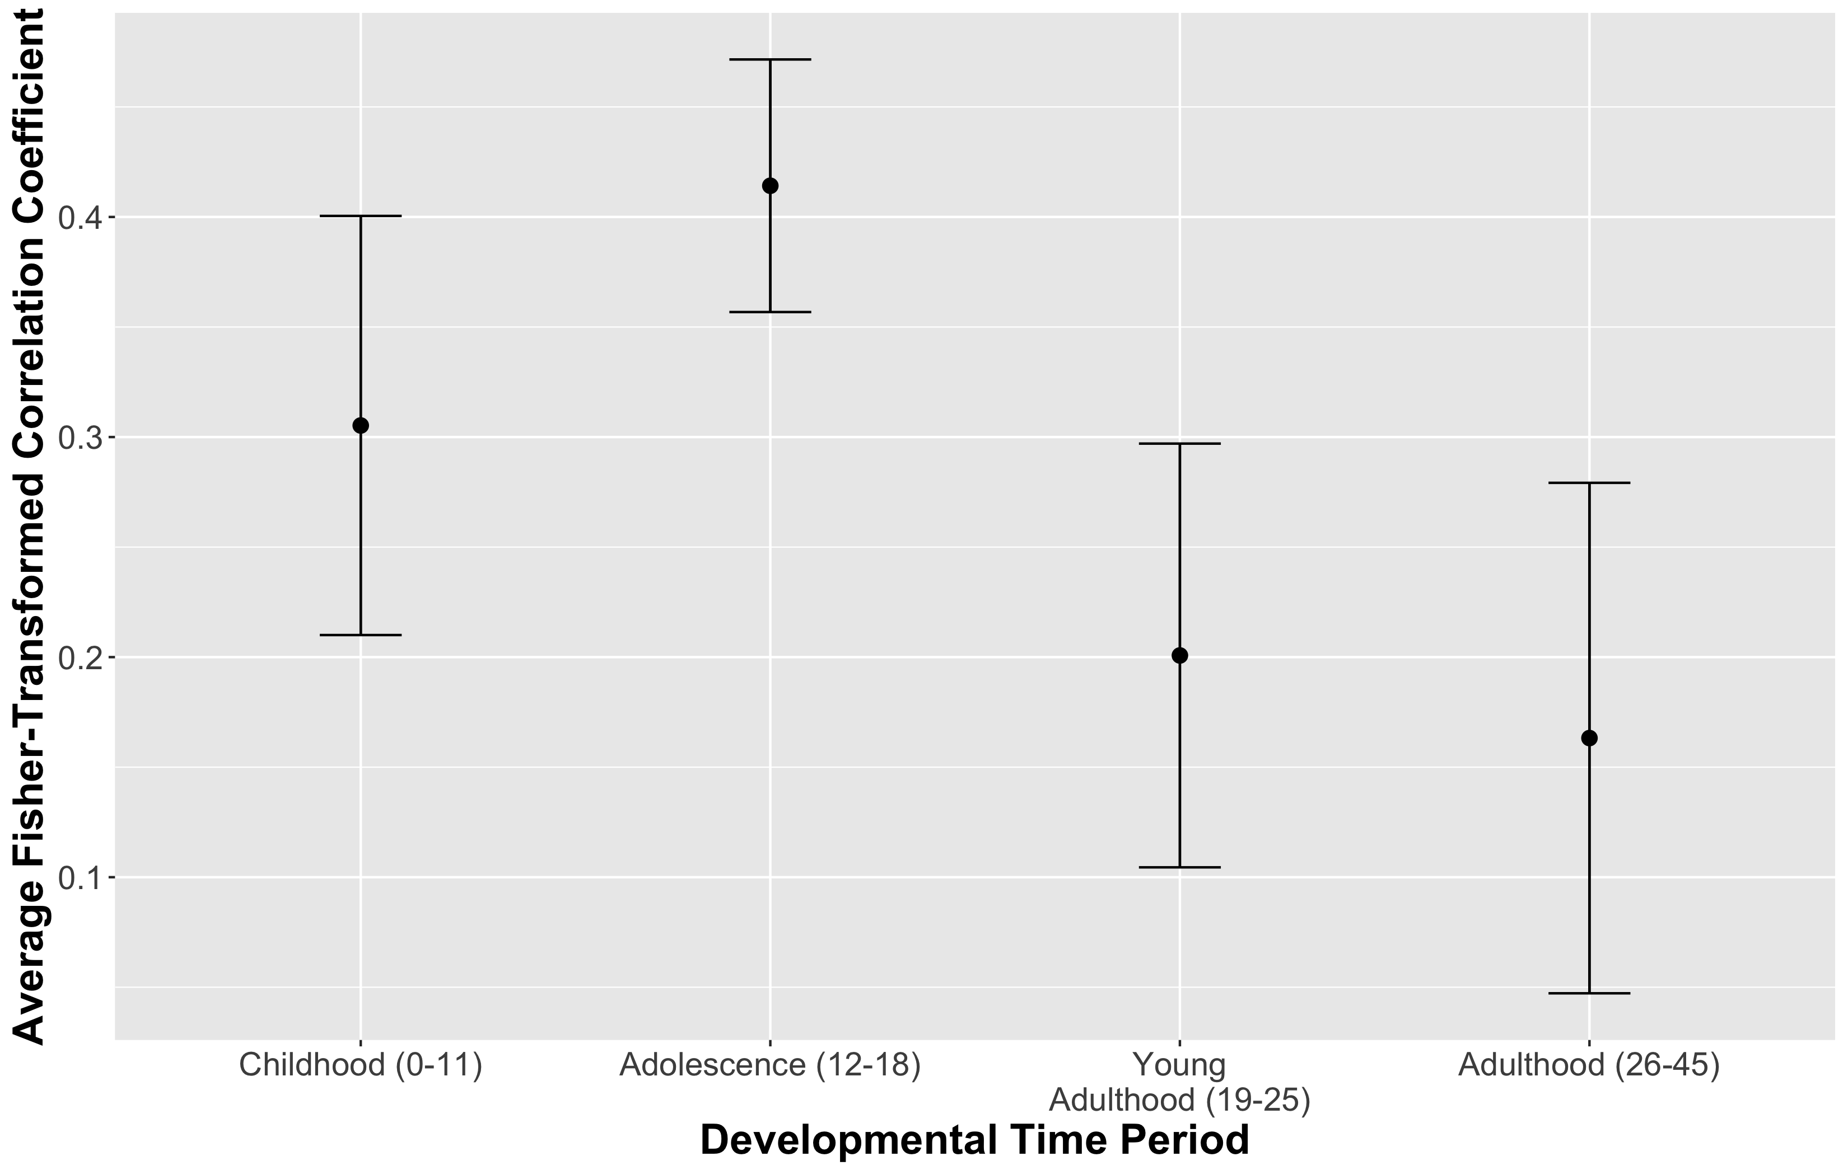

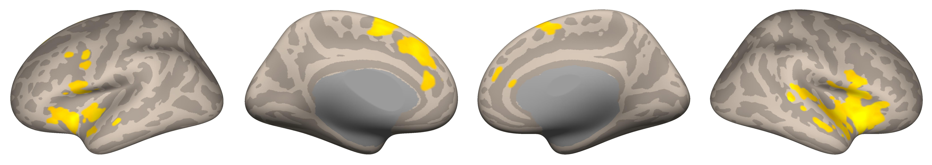

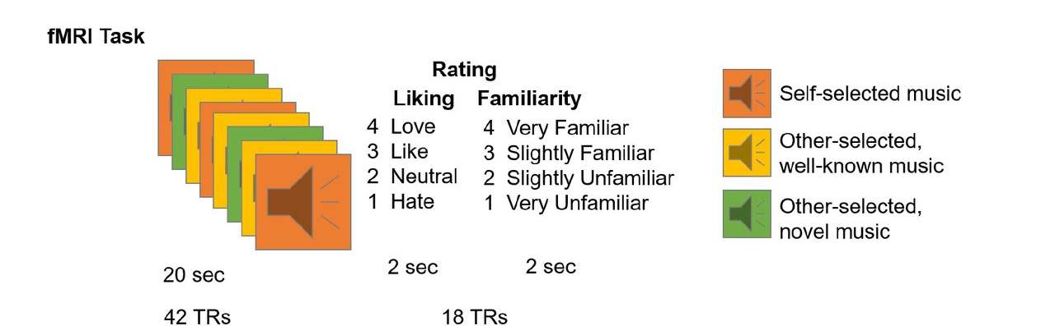
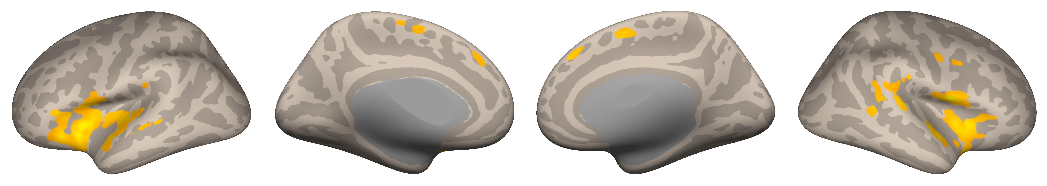
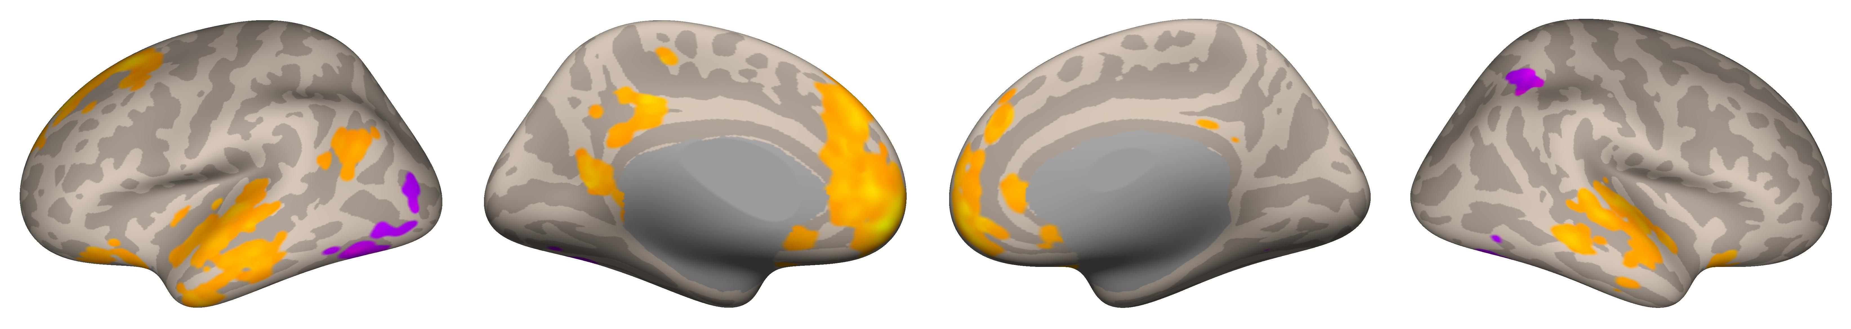


When You Heard it First: Age of Exposure Affects Functional Connectivity between Auditory and Reward Networks
Nicholas Kathios¹, Milena Aiello Quinci¹, Psyche Loui¹
¹Northeastern University
Background
fMRI Data Acquisition & Regions of Interest
Auditory Network Seed-Based Connectivity
Older adults tend to recall a disproportionately high number of autobiographical memories from their adolescence and young adulthood compared to any other time across the lifespan (the “reminiscence bump”)¹
This population recalls more autobiographical memories in response to music from this time and show lifelong preferences for this music:
Adolescents display relatively high sensitivity to reward, attributed to disproportionate maturation of subcortical reward regions compared to regulatory prefrontal regions^{2,3}
Pleasurable music listening experiences involves similar circuitry, as the anterior insula facilitates interactions between the auditory and reward systems:^{5,6}
Taken together, increased preference for music from one’s adolescence might, in part, reflect increased responsivity to & connectivity of reward and auditory regions that persists across the lifespan
Hypothesis: Music first heard in listeners’ adolescence will show functional connectivity patterns that reflect this developmental trajectory
18 cognitively healthy older adults (ages 54-89; M=66.6)
10/18 participants completed a follow-up interview in which they reported when they thought they first heard familiar clips
Clips were categorized based on timing of exposure: childhood (0-11), adolescence (12-18), young adulthood (19-25), and adulthood (26-45) using self-reports & Song-Specific Age (SSA)
fMRI data were acquired using a Siemens Magnetom 3T MR. Continuous acquisition was used for 1440 volumes with a fast TR of 475 ms. Forty-eight axial slices were acquired as echo-planar imaging (EPI) functional volumes covering the whole brain (voxel size = 3 mm³).
Data were preprocessed and analyzed using SPM12 (Statistical Parametric Mapping) software⁷ and the CONN Toolbox⁸.
For seed to whole brain functional connectivity analyses, we seeded the mPFC as defined by the CONN toolbox, the anterior Insula⁹, and the Auditory Network⁶
For ROI-ROI connectivity analyses, we used Reward and Auditory Networks⁶ along with the mPFC & anterior Insula seed
Music encoded during adolescence differed in its functional connectivity patterns from that outside this time period, notably connecting the auditory network & mPFC to reward regions
These preferences may reflect heightened sensitivity to reward-predictive cues in adolescence that persists across the lifespan
Adolescent sensitivity to social reward may also account for these preferences, consistent with the Music for Social Bonding hypothesis¹⁰
Future Directions: Cross-sectional & longitudinal music-listening fMRI studies; investigation of age-related differences on music reward-learning paradigms; SSA fMRI analyses in clinical populations
Rubin, D. C., & Schulkind, M. D. (1997). The distribution of autobiographical memories across the lifespan. Memory & Cognition, 25(6), 859–866. https://doi.org/10.3758/BF03211330
Casey, B. J., Getz, S., & Galvan, A. (2008). The adolescent brain. Developmental Review, 28(1), 62–77. https://doi.org/10.1016/j.dr.2007.08.003
Steinberg, L., Albert, D., Cauffman, E., Banich, M., Graham, S., & Woolard, J. (2008). Age differences in sensation seeking and impulsivity as indexed by behavior and self-report: Evidence for a dual systems model. Developmental Psychology, 44(6), 1764–1778. http://dx.doi.org/10.1037/a0012955
Casey, B., Galván, A., & Somerville, L. H. (2016). Beyond simple models of adolescence to an integrated circuit-based account: A commentary. Developmental Cognitive Neuroscience, 17, 128–130. https://doi.org/10.1016/j.dcn.2015.12.006
Belfi, A. M., & Loui, P. (2020). Musical anhedonia and rewards of music listening: Current advances and a proposed model. Annals of the New York Academy of Sciences, 1464(1), 99–114. https://doi.org/10.1111/nyas.14241
Wang, D., Belden, A., Hanser, S. B., Geddes, M. R., & Loui, P. (2020). Resting-State Connectivity of Auditory and Reward Systems in Alzheimer’s Disease and Mild Cognitive Impairment. Frontiers in Human Neuroscience, 14. https://www.frontiersin.org/article/10.3389/fnhum.2020.00280
Penny, W. D., Friston, K. J., Ashburner, J. T., Kiebel, S. J., & Nichols, T. E. (2011). Statistical Parametric Mapping: The Analysis of Functional Brain Images. Elsevier.
Whitfield-Gabrieli, S., & Nieto-Castanon, A. (2012). Conn: A Functional Connectivity Toolbox for Correlated and Anticorrelated Brain Networks. Brain Connectivity, 2(3), 125–141. https://doi.org/10.1089/brain.2012.0073
Deen, B., Pitskel, N. B., & Pelphrey, K. A. (2011). Three Systems of Insular Functional Connectivity Identified with Cluster Analysis. Cerebral Cortex, 21(7), 1498–1506. https://doi.org/10.1093/cercor/bhq186
Savage, P. E., Loui, P., Tarr, B., Schachner, A., Glowacki, L., Mithen, S., & Fitch, W. T. (2021). Music as a coevolved system for social bonding. Behavioral and Brain Sciences, 44. https://doi.org/10.1017/S0140525X20000333
We acknowledge support from Grammy Foundation, NSF-CAREER 1945436, NSF-STTR 2014870, and Kim and Glenn Campbell Foundation.
Childhood (0-11):
Adolescence (12-18):
Young Adulthood (19-25):
Univariate Main Effect of Age of Exposure
Voxel Threshold: p FDR-corrected <0.05; Cluster Threshold: p FDR-corrected <0.05
Music from adulthood (26-45) did not survive corrections
ROI-ROI Connectivity
Adolescence (12-18):
Young Adulthood (19-25):
Voxel Threshold: p FDR-corrected <0.05; Cluster Threshold: p FDR-corrected <0.05
Music from childhood (0-11) and adulthood (26-45) did not survive corrections
Anterior Insula Seed-Based Connectivity
Childhood (0-11):
Discussion
Methods
Adolescence (12-18):
Childhood
Adolescence
Voxel Threshold: p-FDR corrected <0.05; Cluster Threshold: p FDR-corrected <0.05
Music from young adulthood (19-25) and adulthood (26-45) did not survive corrections
mPFC Seed-Based Connectivity
References
Adolescence (12-18):
Voxel Threshold: p FDR-corrected <0.05; Cluster Threshold: p FDR-corrected <0.05
Music from childhood (0-11), young adulthood (19-26), and adulthood (26-45) did not survive corrections
Notes:
This poster was inspired by the “reminiscence bump” effect, or the tendency of older adults to be able to recall a disproportionately high amount of autobiographical memories from their adolescence & young adulthood compared to any other time across the lifespan.
In fact, neurodevelopment in adolescence seems to support this suggestion, as adolescence is a time in which individuals are highly sensitive to rewards. This sensitivity has been attributed to the rapid maturation of subcortical reward regions during this time, and circuit-based models suggest that regulatory prefrontal connections to the reward system develop throughout adolescence.
Importantly, these regions & connections are quite important in pleasurable music experiences, which involve interactions between the auditory system + reward regions, facilitated by the anterior insula

